Slide 1
using the ethz computer cluster
Lab meeting 21/09/2020
Bernat Bramon Mora
ETH Zürich
Plant Ecology group

Slide 2
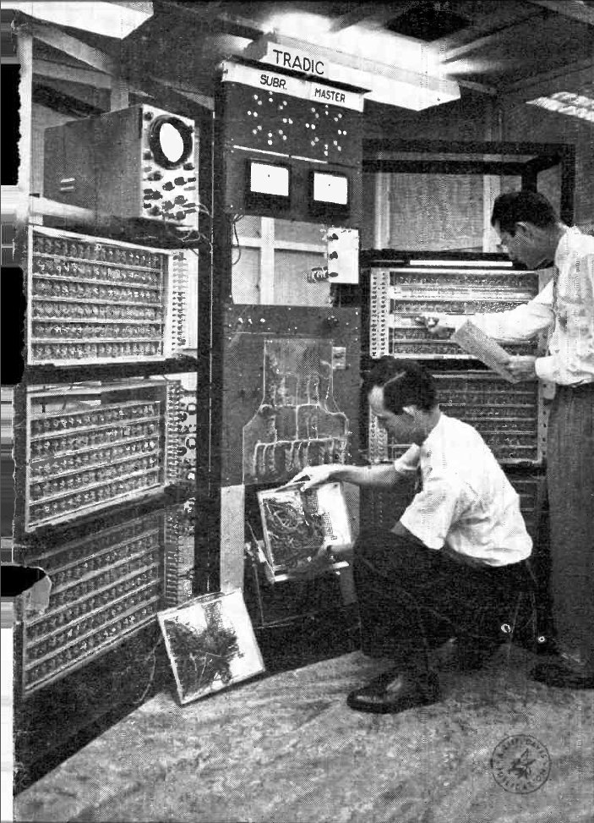
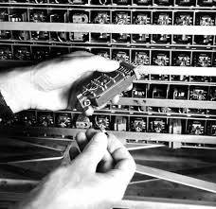

Slide 3
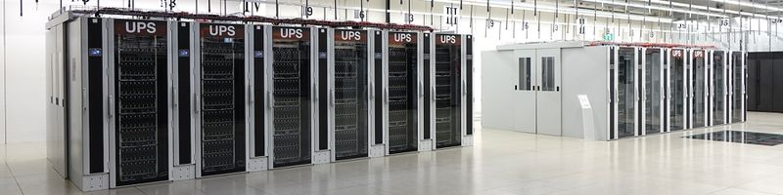
What is a computer cluster?

Slide 4
What is a computer cluster?
… it’s just a set of computers

Slide 6
none

Slide 7
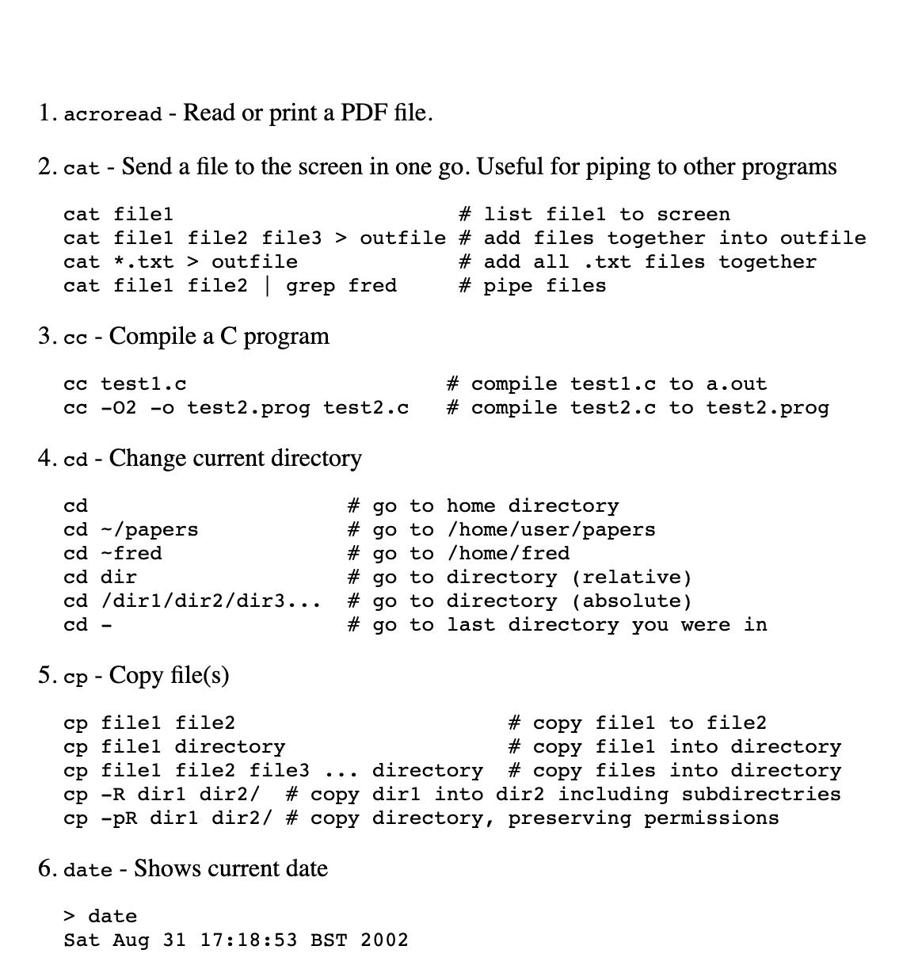
Basic Shell Commands
. . .

Slide 8
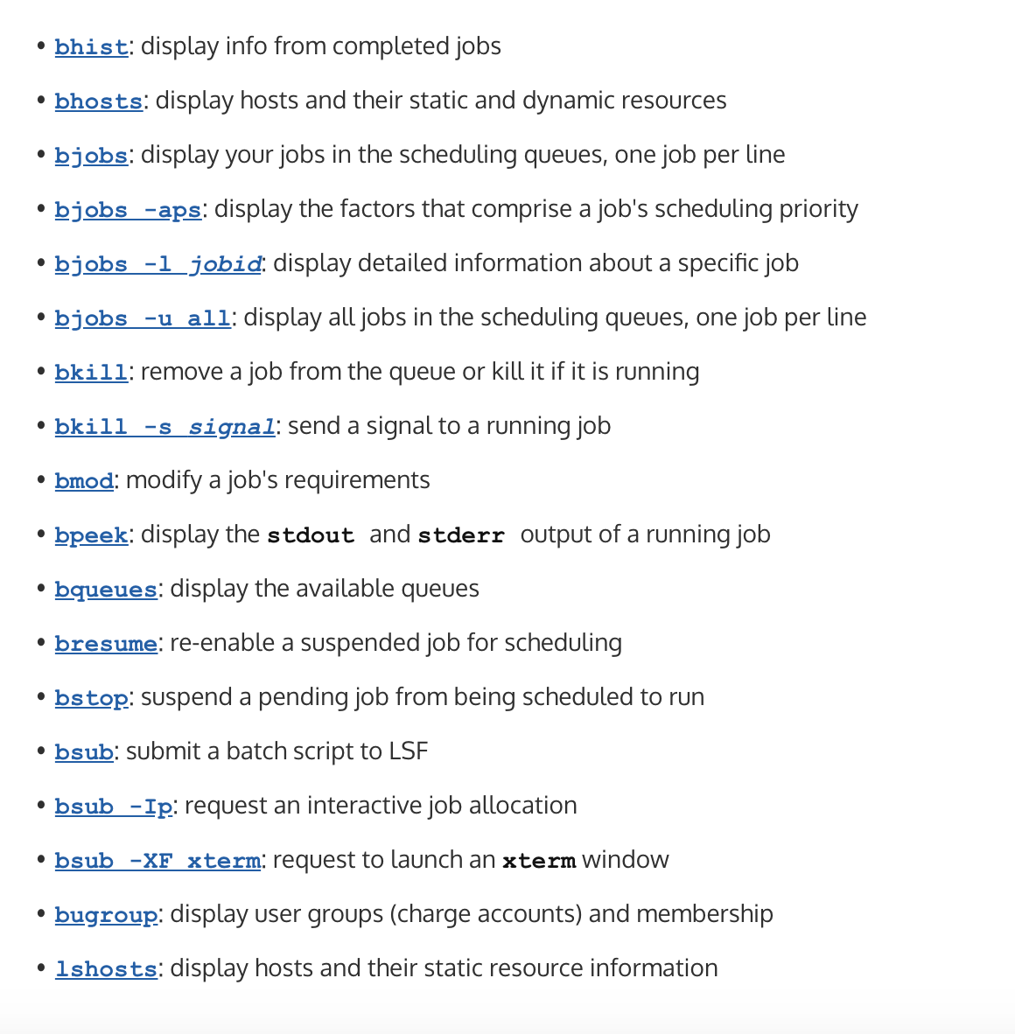
Basic Shell Commands
Using the Euler’s batch system
. . .

Slide 9
Basic Shell Commands
Using the Euler’s batch system
. . .

Slide 10
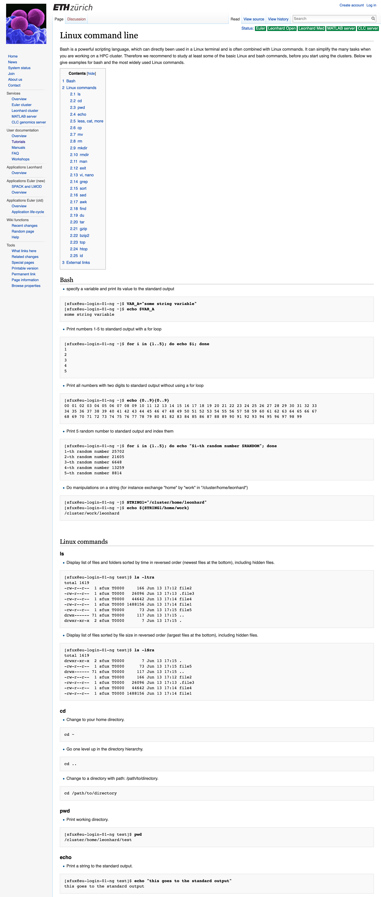

Slide 11
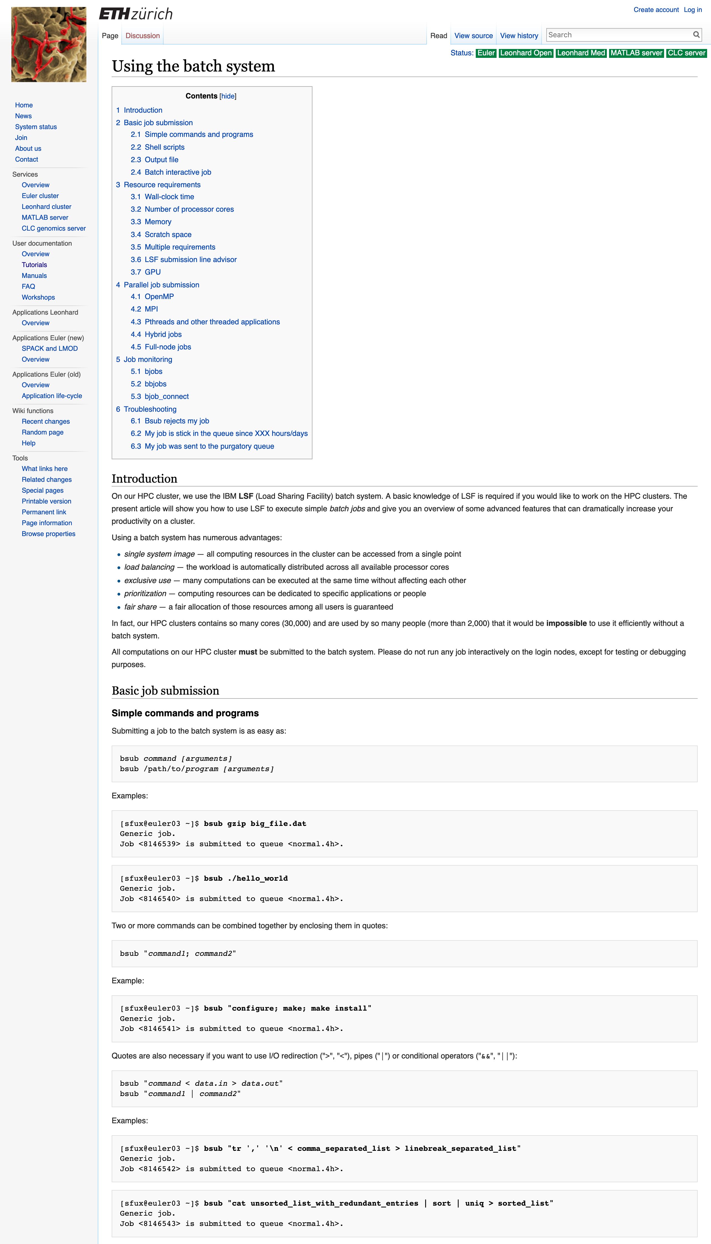

Slide 12
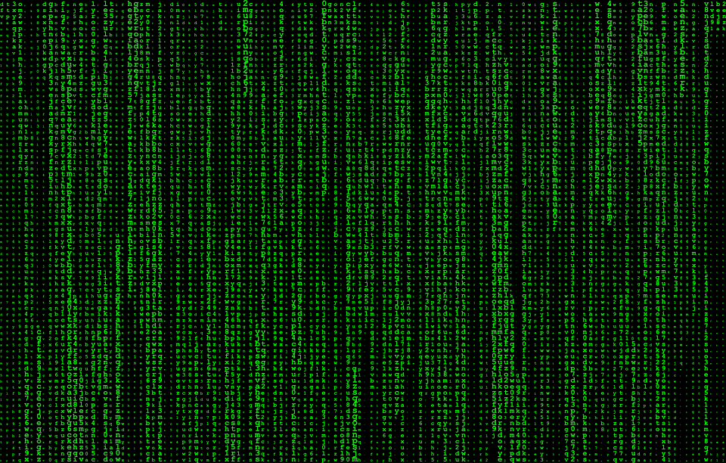

Slide 13
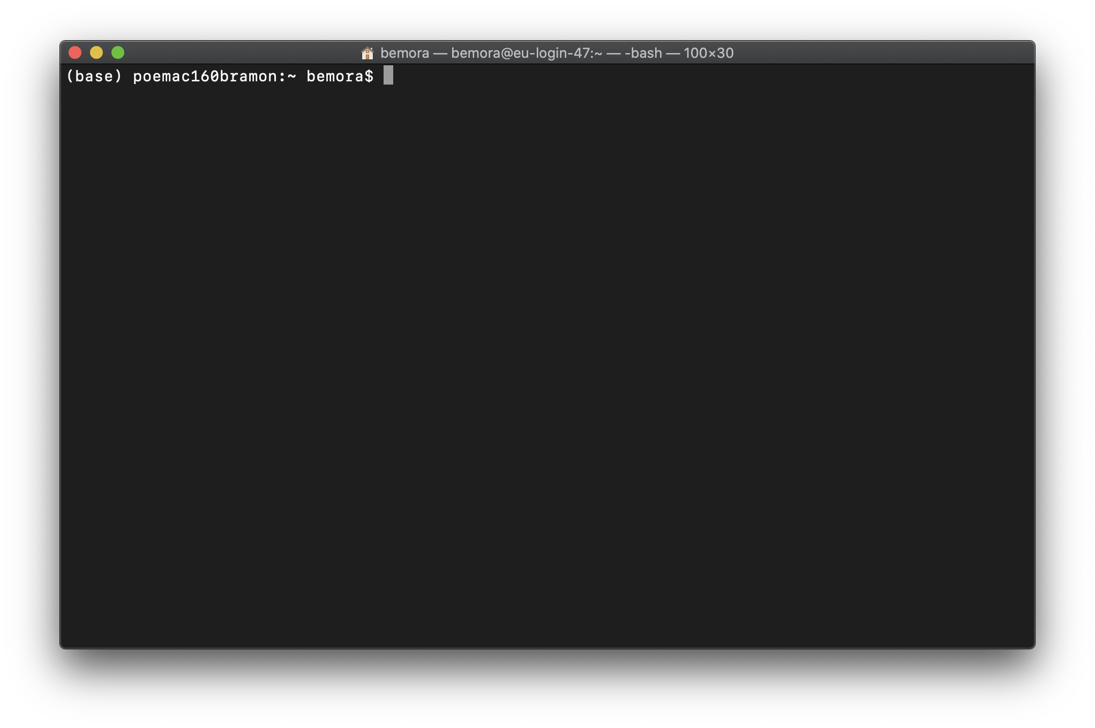
ssh

Slide 14
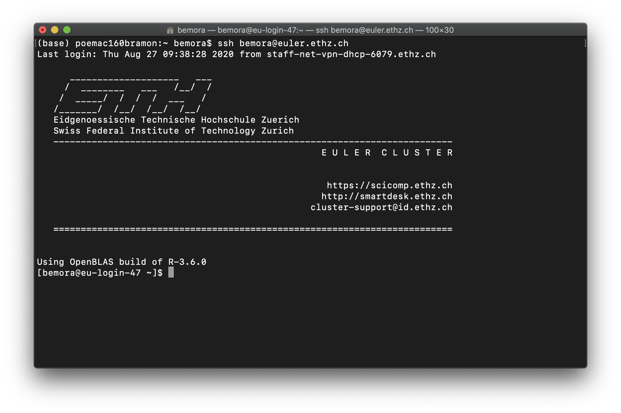
ssh

Slide 15
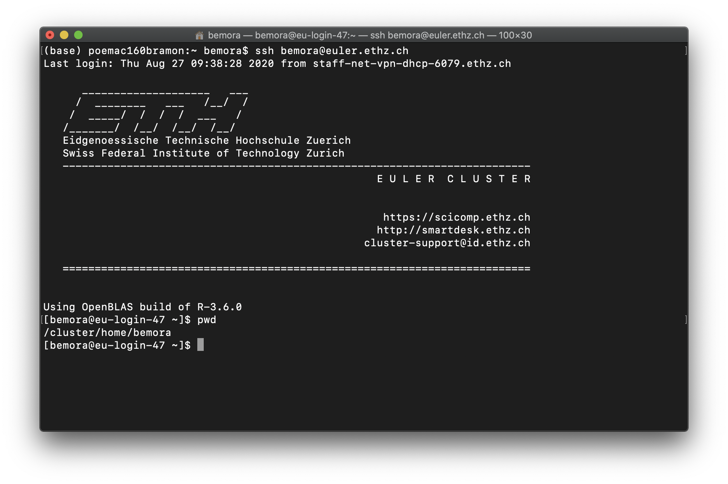
ssh

Slide 16
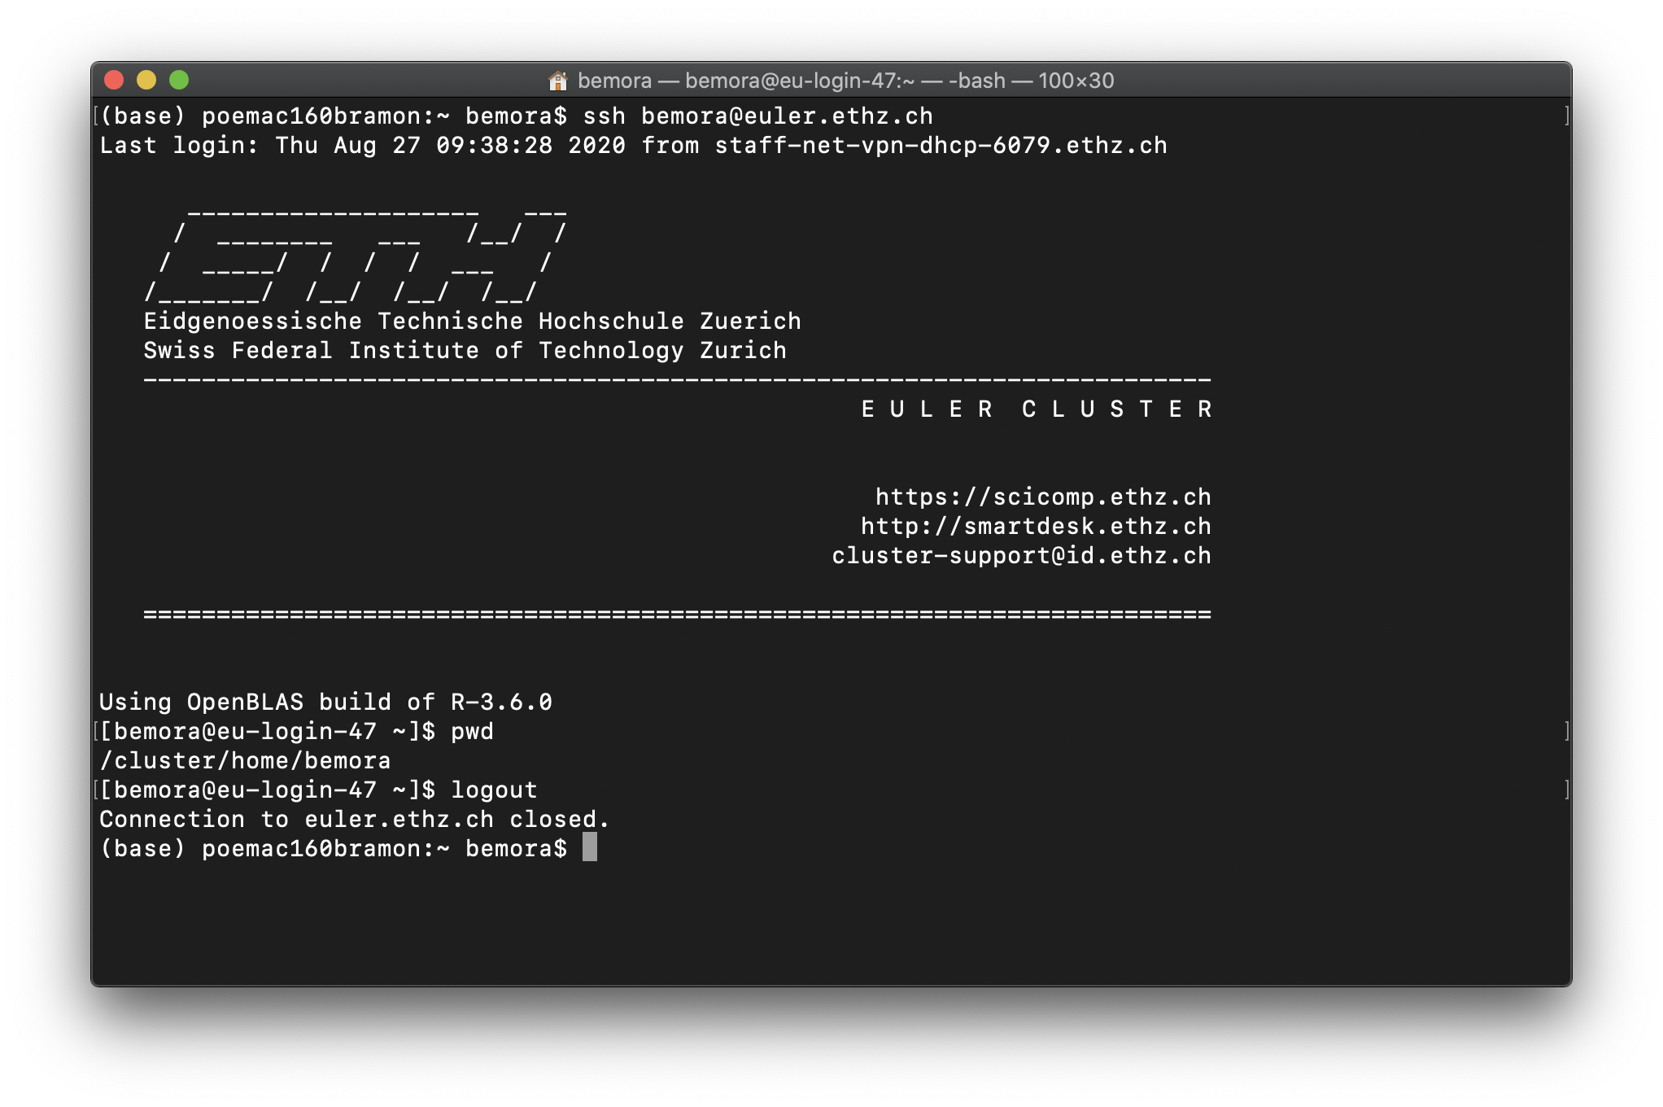
ssh

Slide 17
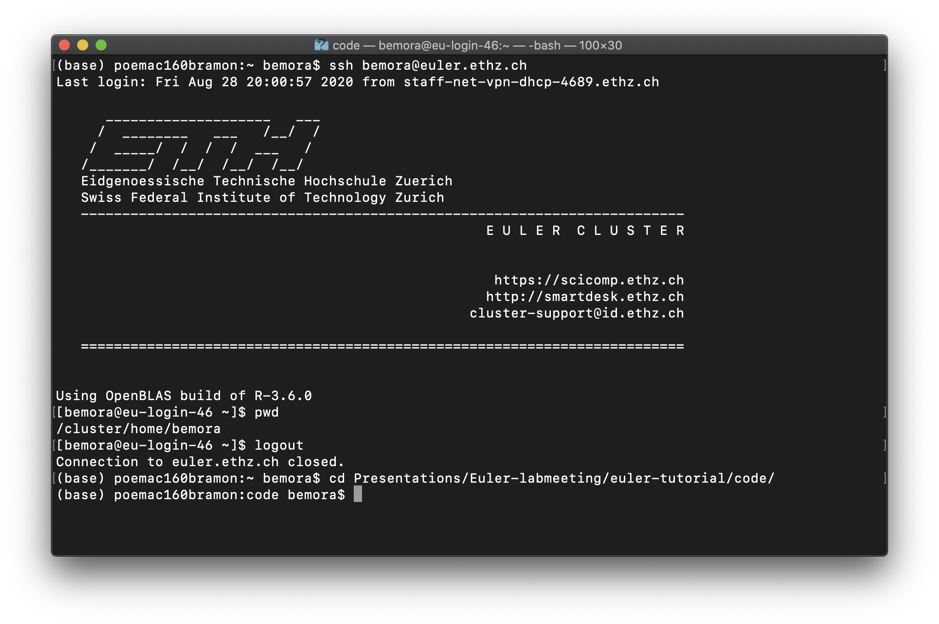
find your script…

Slide 18
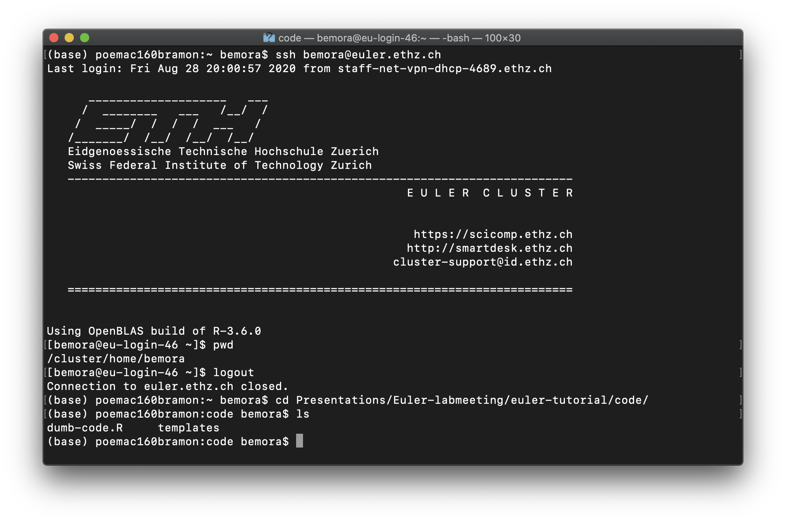
find your script…

Slide 19
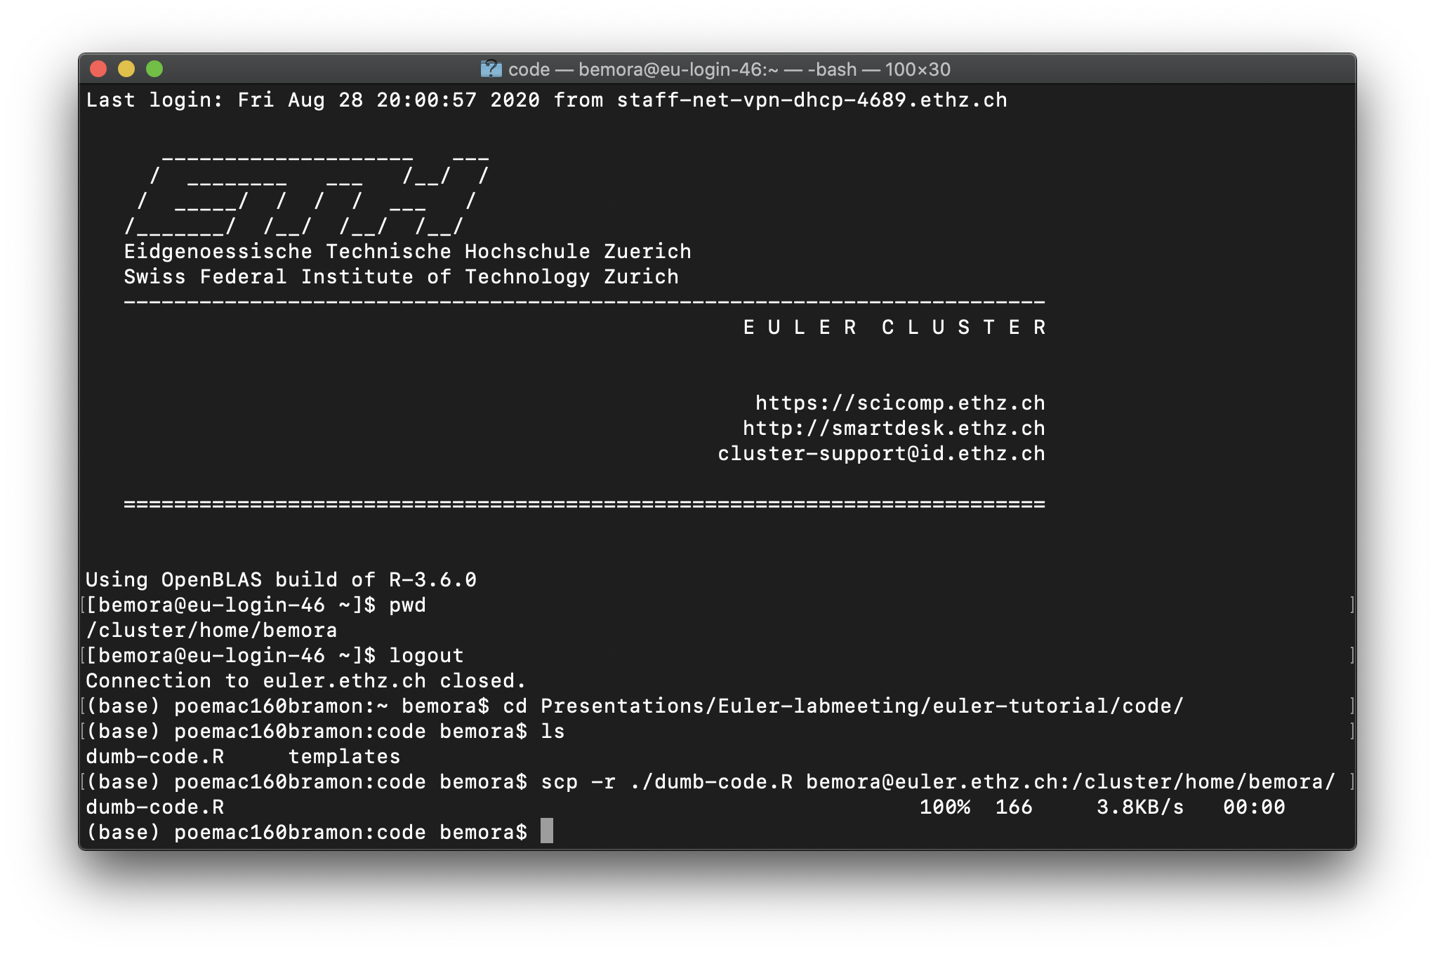
scp

Slide 20
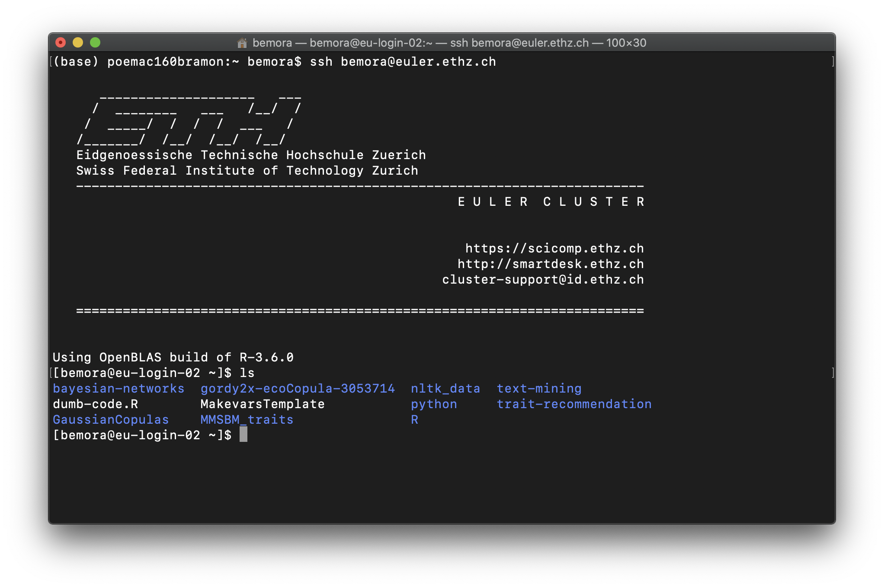
scp

Slide 21
scp

Slide 22
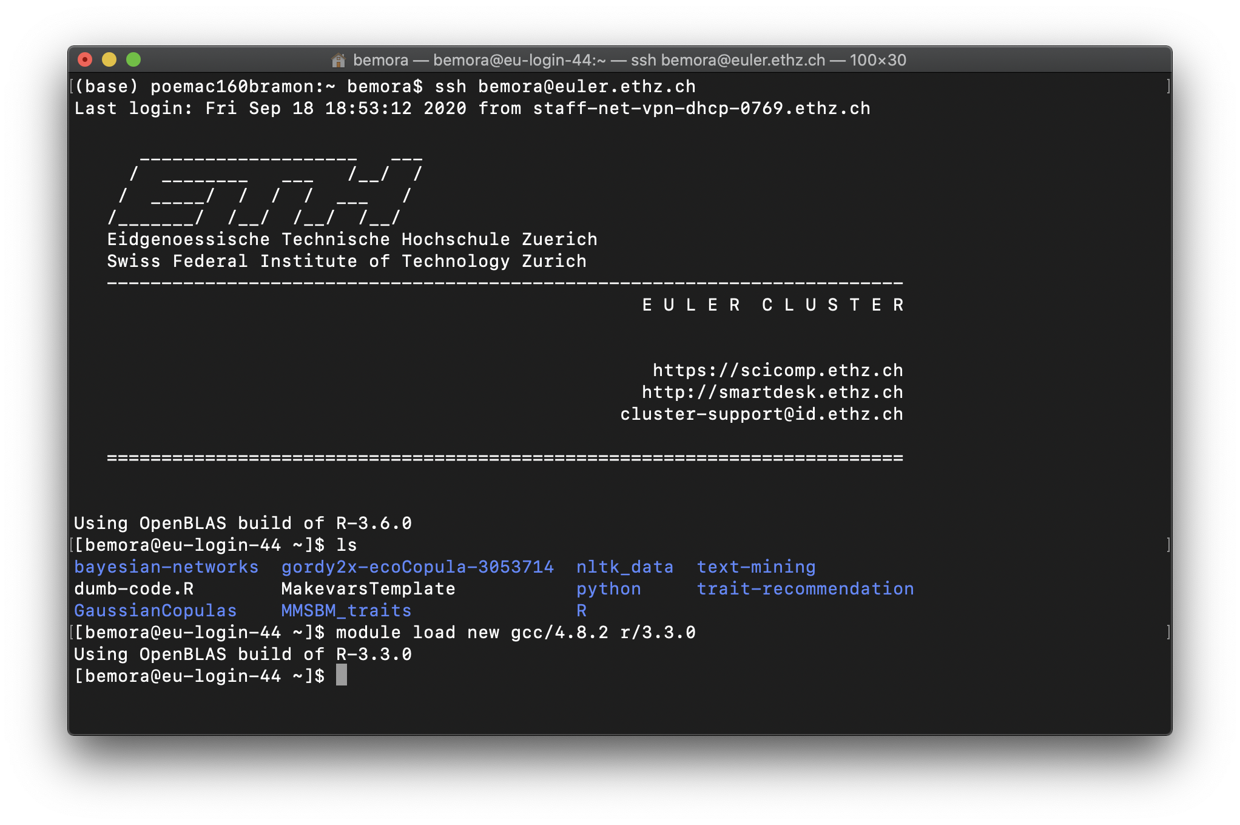
load R and compiler

Slide 23
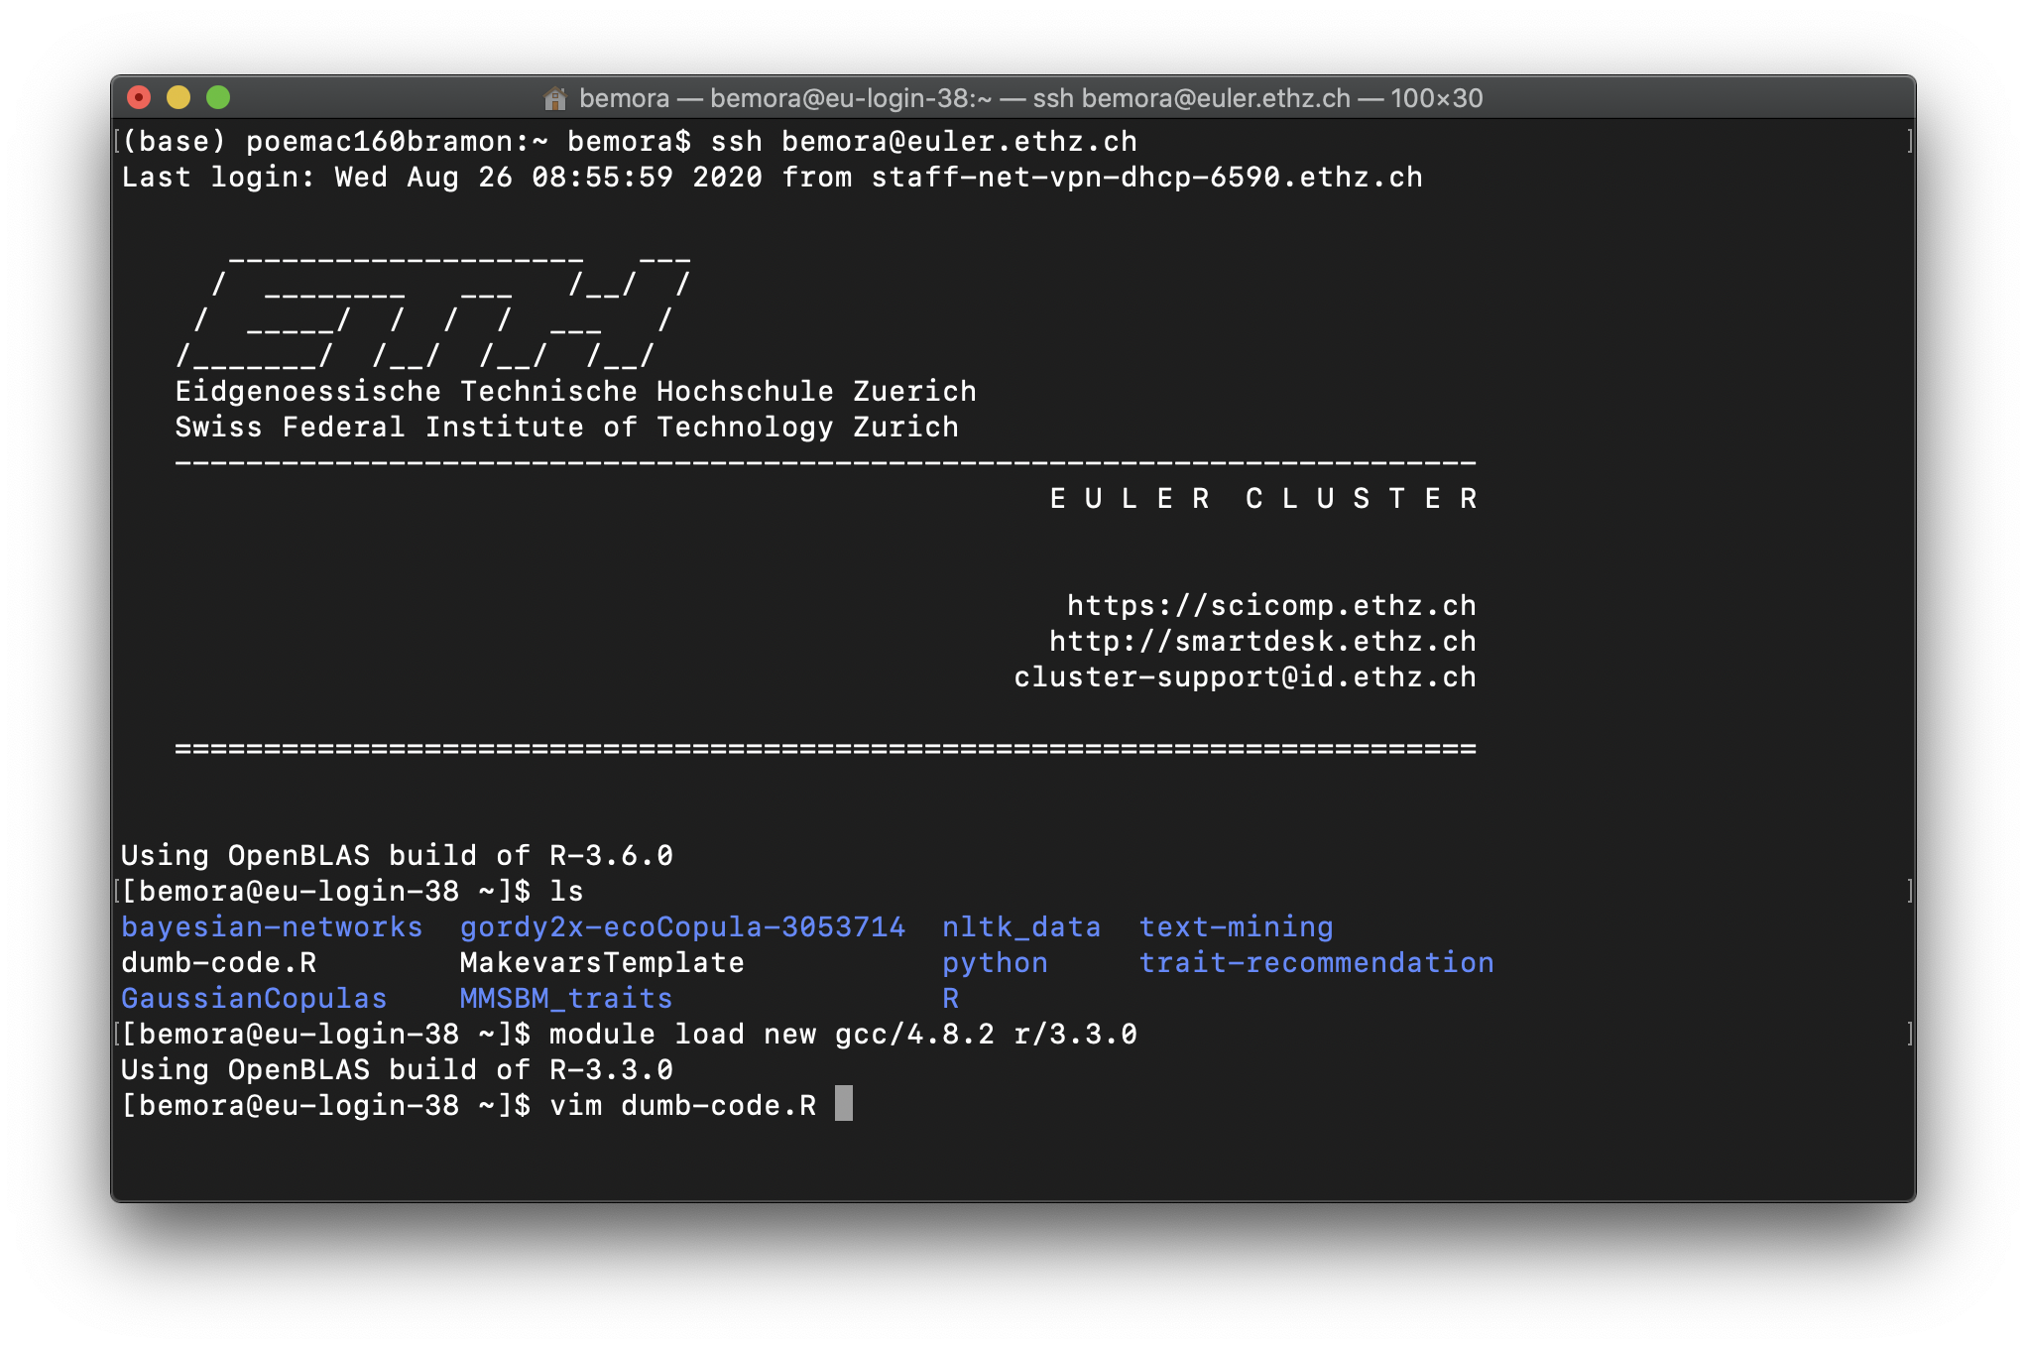
Edit script

